Slide 1
Error Detection and Correction

Slide 2
Session Objectives
After going through this session you will learn
Types of error
Block Coding Technique
Cyclic Codes (CRC)
Checksum
Notes:
1.#

Slide 3
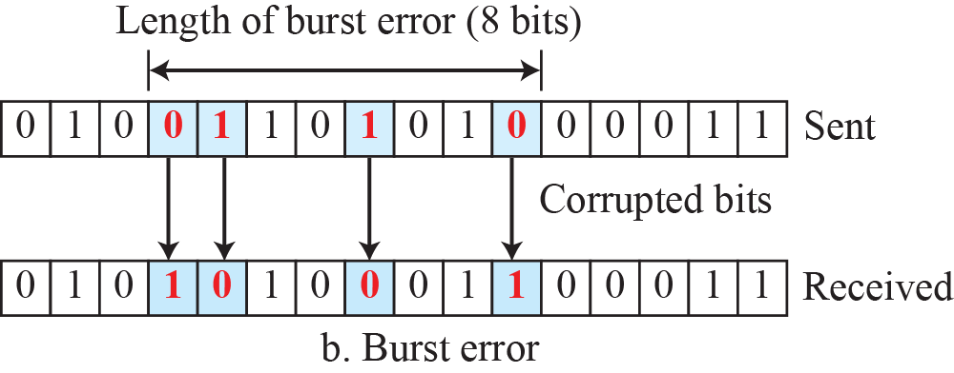
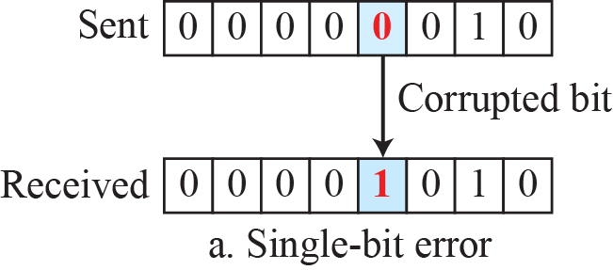
Types of Errors
Whenever bits flow from one point to another, they are subject to unpredictable changes because of interference. This interference can change the shape of the signal.
The term single-bit error means that only 1 bit of a given data unit (such as a byte, character, or packet) is changed from 1 to 0 or from 0 to 1.
The term burst error means that 2 or more bits in the data unit have changed from 1 to 0 or from 0 to 1. Figure below shows the effect of a single-bit and a burst error on a data unit.
Notes:
1.#

Slide 4
Redundancy Bits
The central concept in detecting or correcting errors is redundancy.
To be able to detect or correct errors, we need to send some extra bits with our data.
These redundant bits are added by the sender and removed by the receiver.
Their presence allows the receiver to detect or correct corrupted bits.
Notes:
12.#

Slide 5
Detection versus Correction
The correction of errors is more difficult than the detection.
In error detection, we are only looking to see if any error has occurred.
The answer is a simple yes or no. We are not even interested in the number of corrupted bits.
A single-bit error is the same for us as a burst error. In error correction, we need to know the exact number of bits that are corrupted and, more importantly, their location in the message.
Notes:
12.#

Slide 6
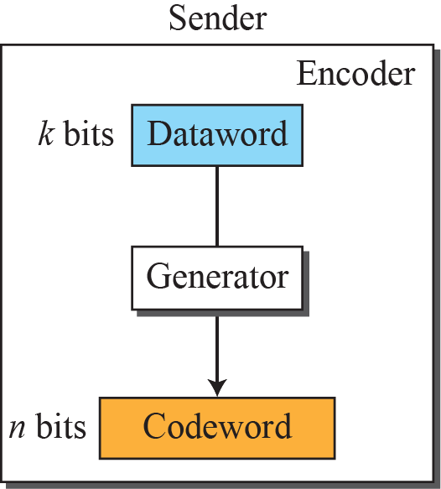
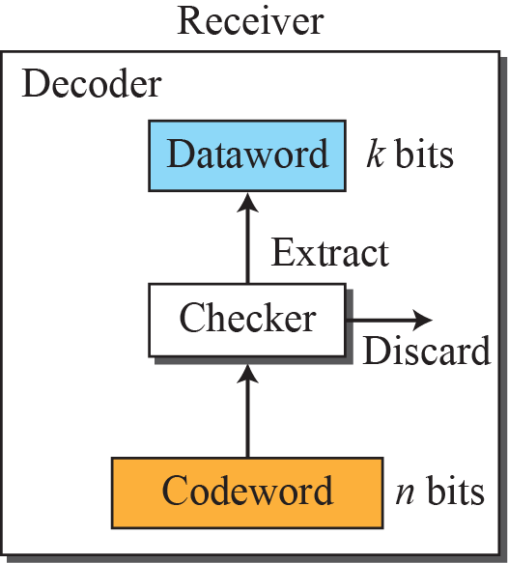

Block Coding Technique
In block coding, we divide our message into blocks, each of k bits, called data-words.
We add r redundant bits to each block to make the length n = k + r.
The resulting n-bit blocks are called code-words.
Error detection using Block Coding
Applying some conditions, the receiver can detect a change in the codeword.
The receiver has (or can find) a list of valid codewords.
The original codeword has changed to an invalid one.
Notes:
12.#

Slide 7
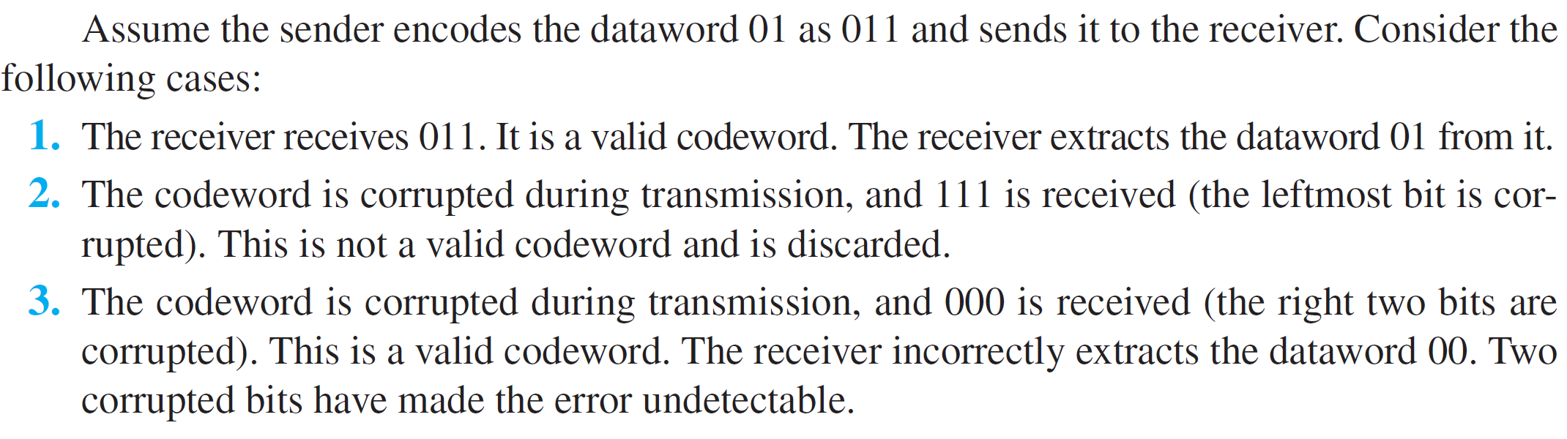
Example 1
Let us assume that k = 2 and n = 3. Table 10.1 shows the list of datawords and codewords. Later, we will see how to derive a codeword from a dataword.
Table 1: A code for error detection
Notes:
12.#

Slide 8
Hamming Distance between two codes
The minimum Hamming distance for our first code scheme is 2. This code guarantees detection of only a single error. For example, if the third codeword (101) is sent and one error occurs, the received codeword does not match any valid codeword. If two errors occur, however, the received codeword may match a valid codeword and the errors are not detected.
Conclusion
A code scheme has a Hamming distance dmin = 4. This code guarantees the detection of up to three errors d = s + 1 or s = 3).
The code in Table 1 is a linear block code because the result of XORing any codeword with any other codeword is a valid codeword. For example, the XORing of the second and third codewords creates the fourth one.
Notes:
12.#

Slide 9
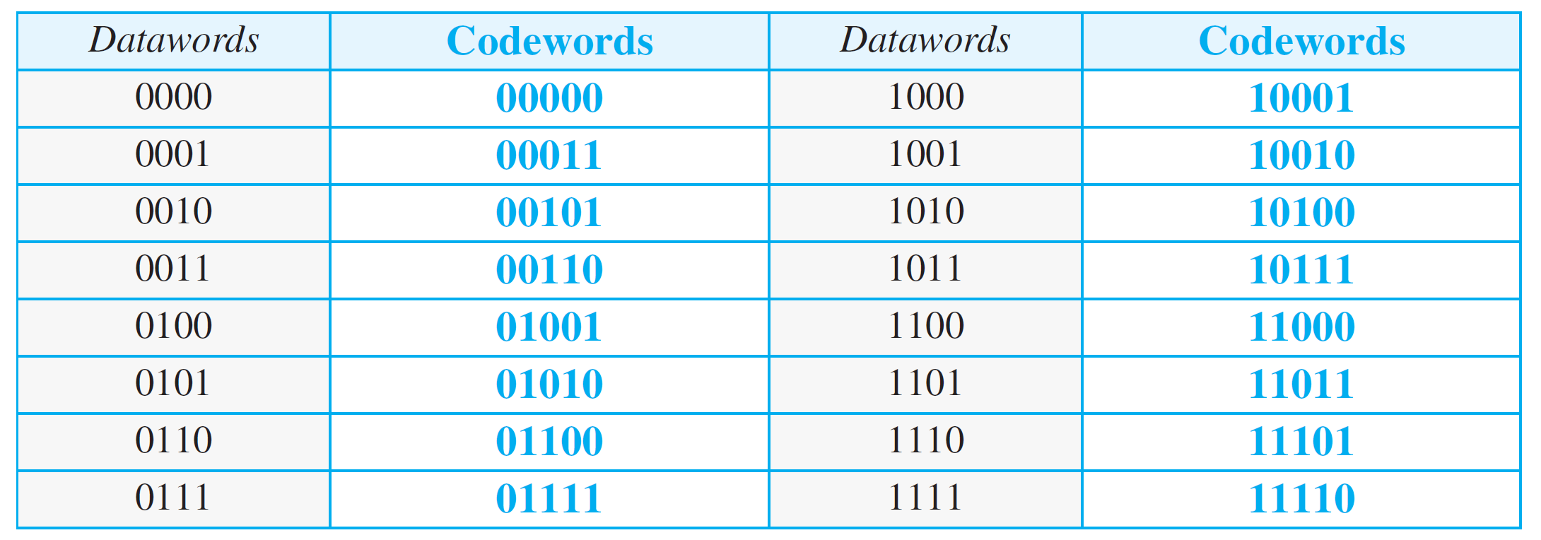
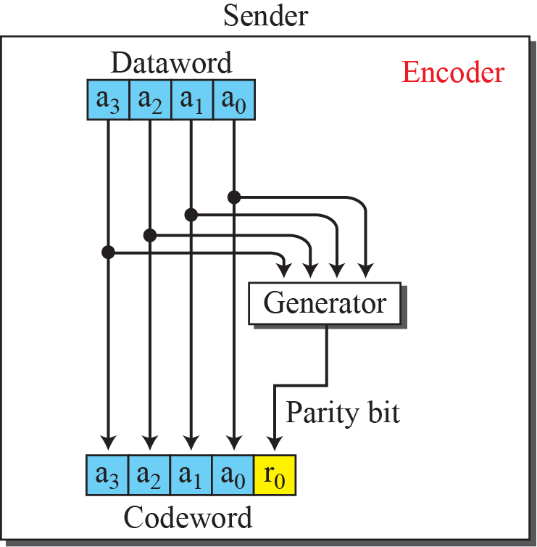
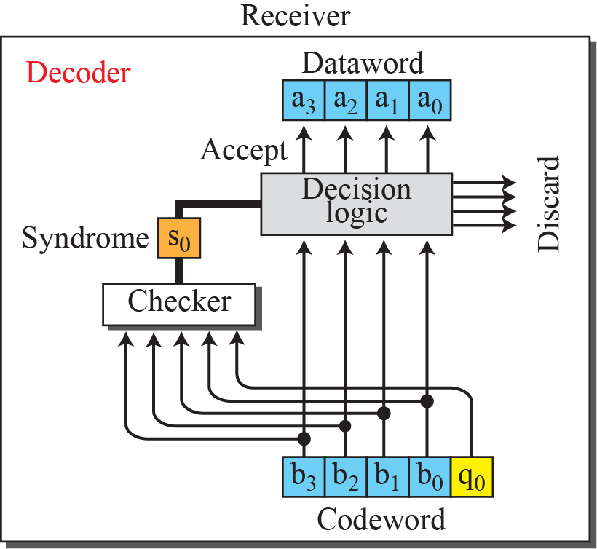
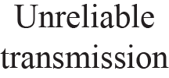
Table 2: Parity Checking Method C(5, 4)
Notes:
12.#

Slide 10
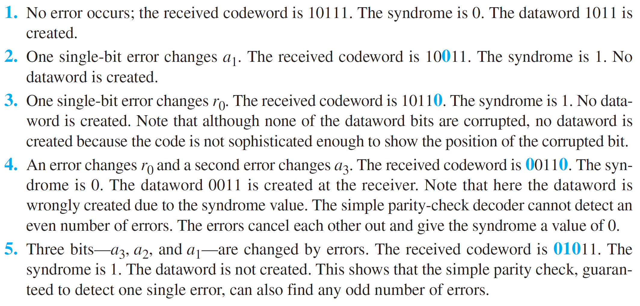
Example 2
Let us look at some transmission scenarios. Assume the sender sends the dataword 1011. The codeword created from this dataword is 10111, which is sent to the receiver. We examine five cases:
Notes:
12.#

Slide 11
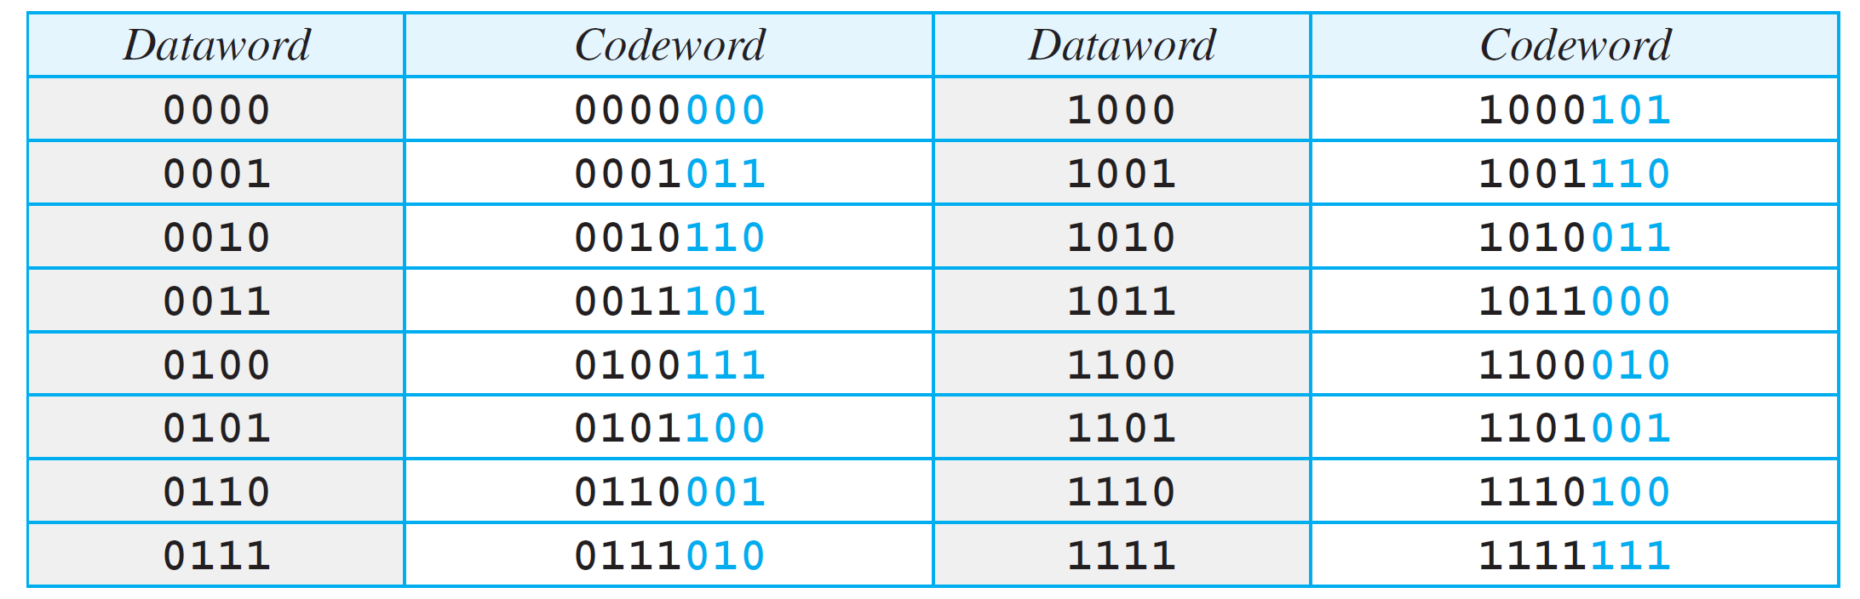
Cyclic Codes (CRC) Method
Cyclic codes are special linear block codes with one extra property.
In a cyclic code, if a codeword is cyclically shifted (rotated), the result is another codeword.
For example, if 1011000 is a codeword and we cyclically left-shift, then 0110001 is also a codeword.
Example: Cyclic code for C(7, 4) is shown below
Notes:
12.#

Slide 12
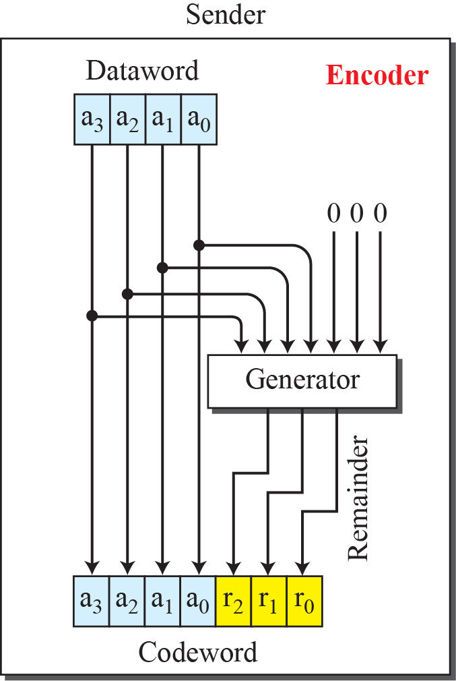
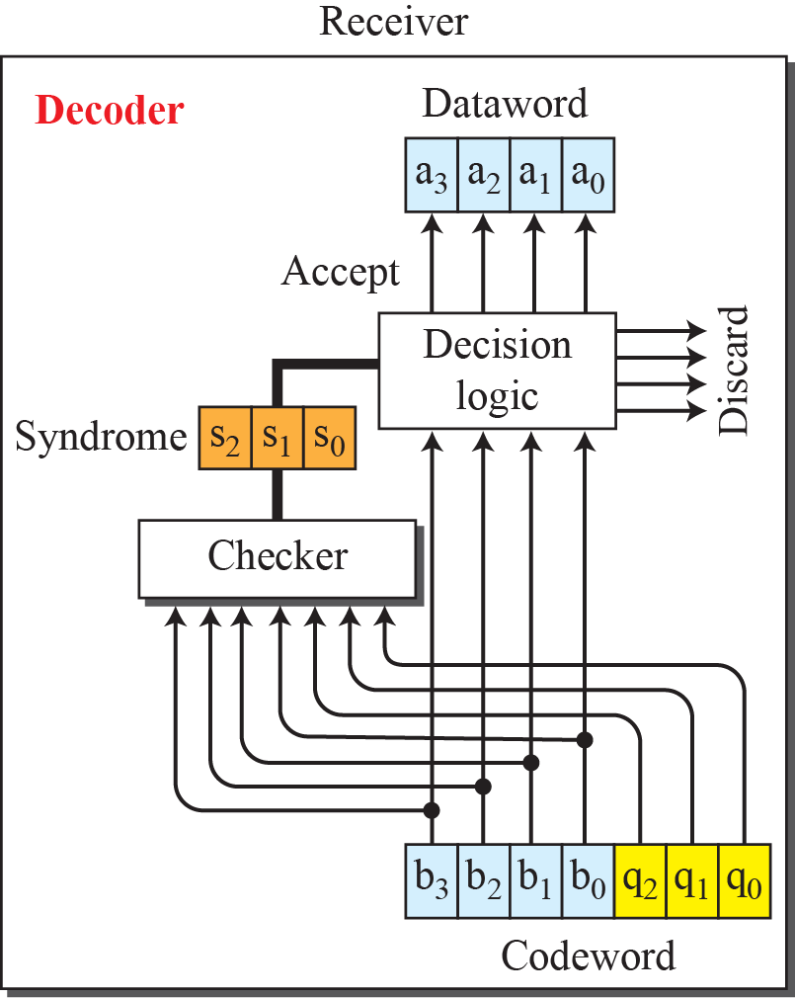
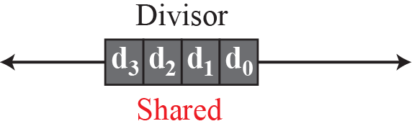
CRC Encoder and Decoder
Notes:
12.#

Slide 13
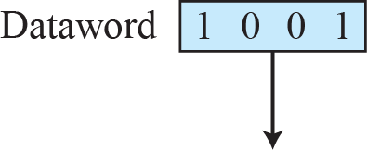
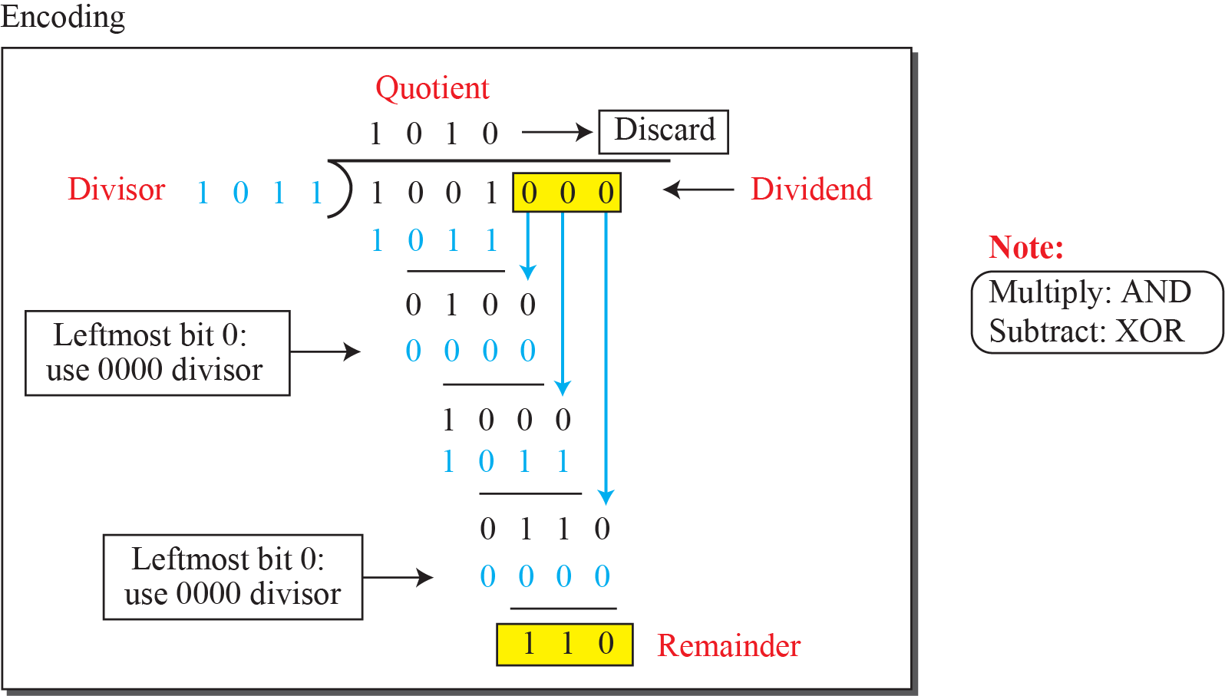
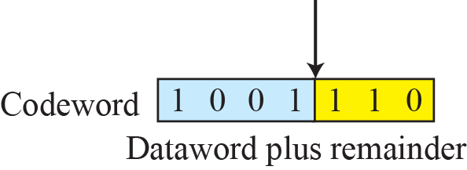
Division in CRC Encoder
Notes:
12.#

Slide 14
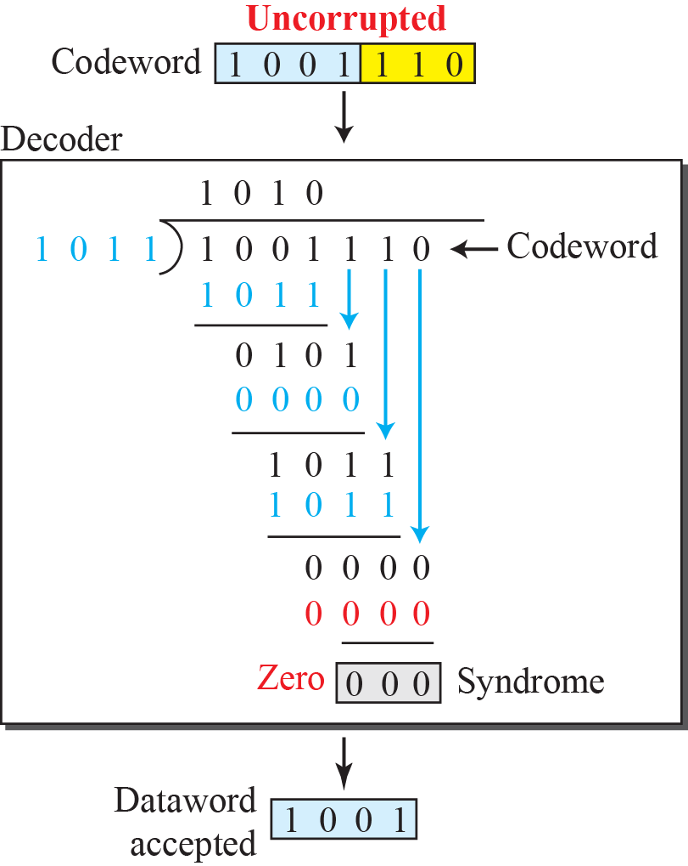
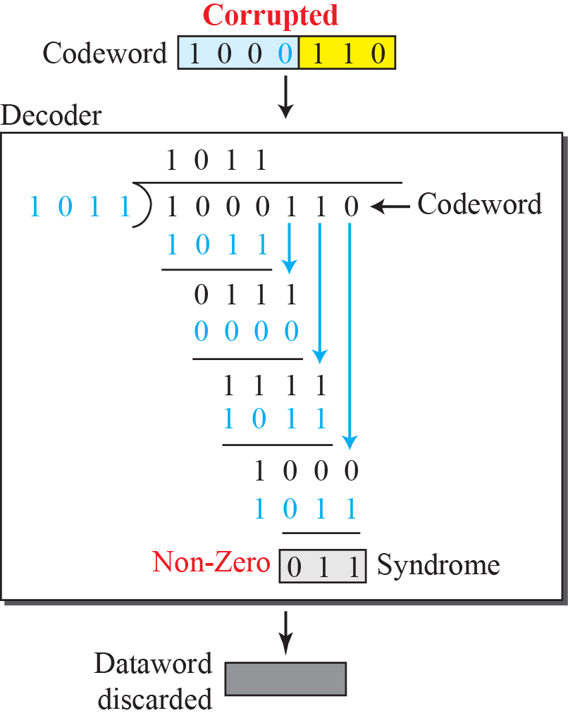
Division in CRC Decoder for Two cases
Notes:
12.#

Slide 15
CRC Advantages
Cyclic codes have a very good performance in detecting single-bit errors, double errors, an odd number of errors, and burst errors.
They can easily be implemented in hardware and software.
They are especially fast when implemented in hardware.
Notes:
12.#

Slide 16
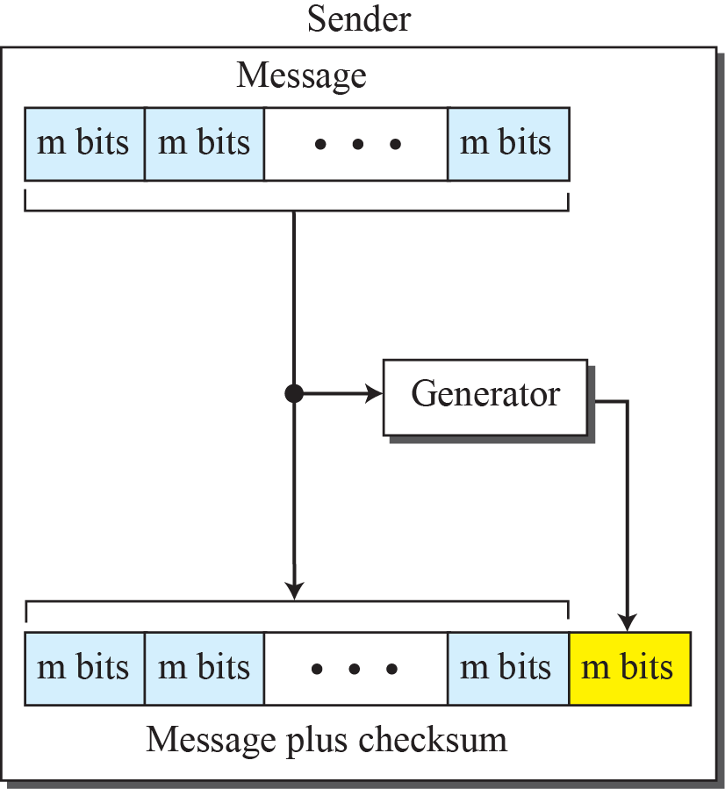
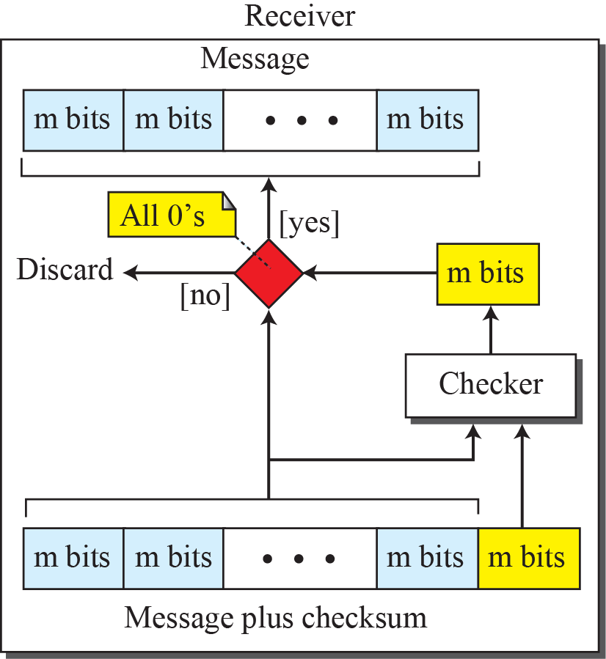
Checksum Method
Checksum is an error-detecting technique that can be applied to a message of any length.
In the Internet, the checksum technique is mostly used at the network and transport layer rather than the data-link layer.

Slide 17
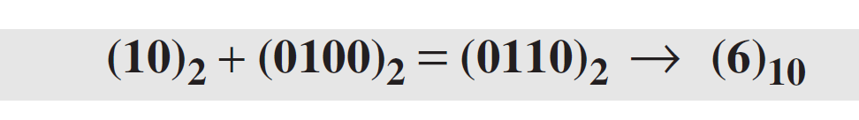
Checksum Illustration with an Example
Suppose the message is a list of five 4-bit numbers that we want to send to a destination. In addition to sending these numbers, we send the sum of the numbers. For example, if the set of numbers is (7, 11, 12, 0, 6), we send (7, 11, 12, 0, 6, 36), where 36 is the sum of the original numbers. The receiver adds the five numbers and compares the result with the sum. If the two are the same, the receiver assumes no error, accepts the five numbers, and discards the sum. Otherwise, there is an error somewhere and the message not accepted.
Explanation:
In the example, the decimal number 36 in binary is (100100)2. To change it to a 4-bit number we add the extra leftmost bit to the right four bits as shown below.
Instead of sending 36 as the sum, we can send 6 as the sum (7, 11, 12, 0, 6, 6). The receiver can add the first five numbers in one’s complement arithmetic. If the result is 6, the numbers are accepted; otherwise, they are rejected.
Notes:
12.#

Slide 18
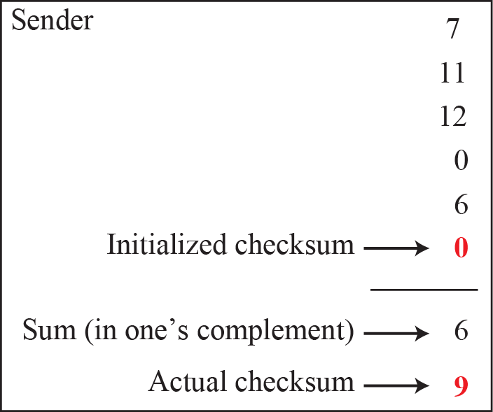
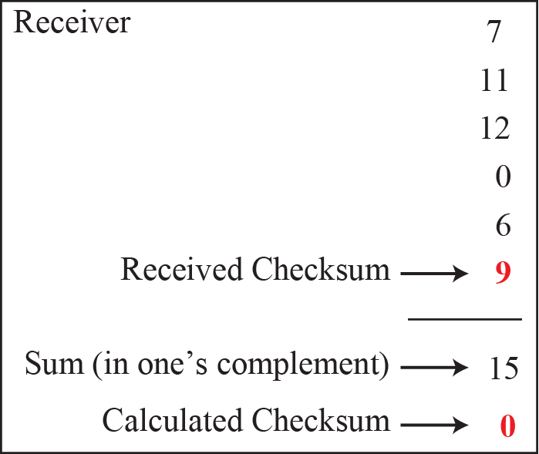
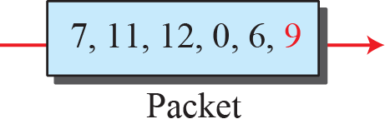
Using idea of Checksum
Let us use the idea of the checksum in previous example. The sender adds all five numbers in one’s complement to get the sum = 6. The sender then complements the result to get the checksum = 9, which is 15 − 6. Note that 6 = (0110)2 and 9 = (1001)2; they are complements of each other.
The sender sends the five data numbers and the checksum (7, 11, 12, 0, 6, 9). If there is no corruption in transmission, the receiver receives (7, 11, 12, 0, 6, 9) and adds them in one’s complement to get 15.
Notes:
12.#

Slide 19
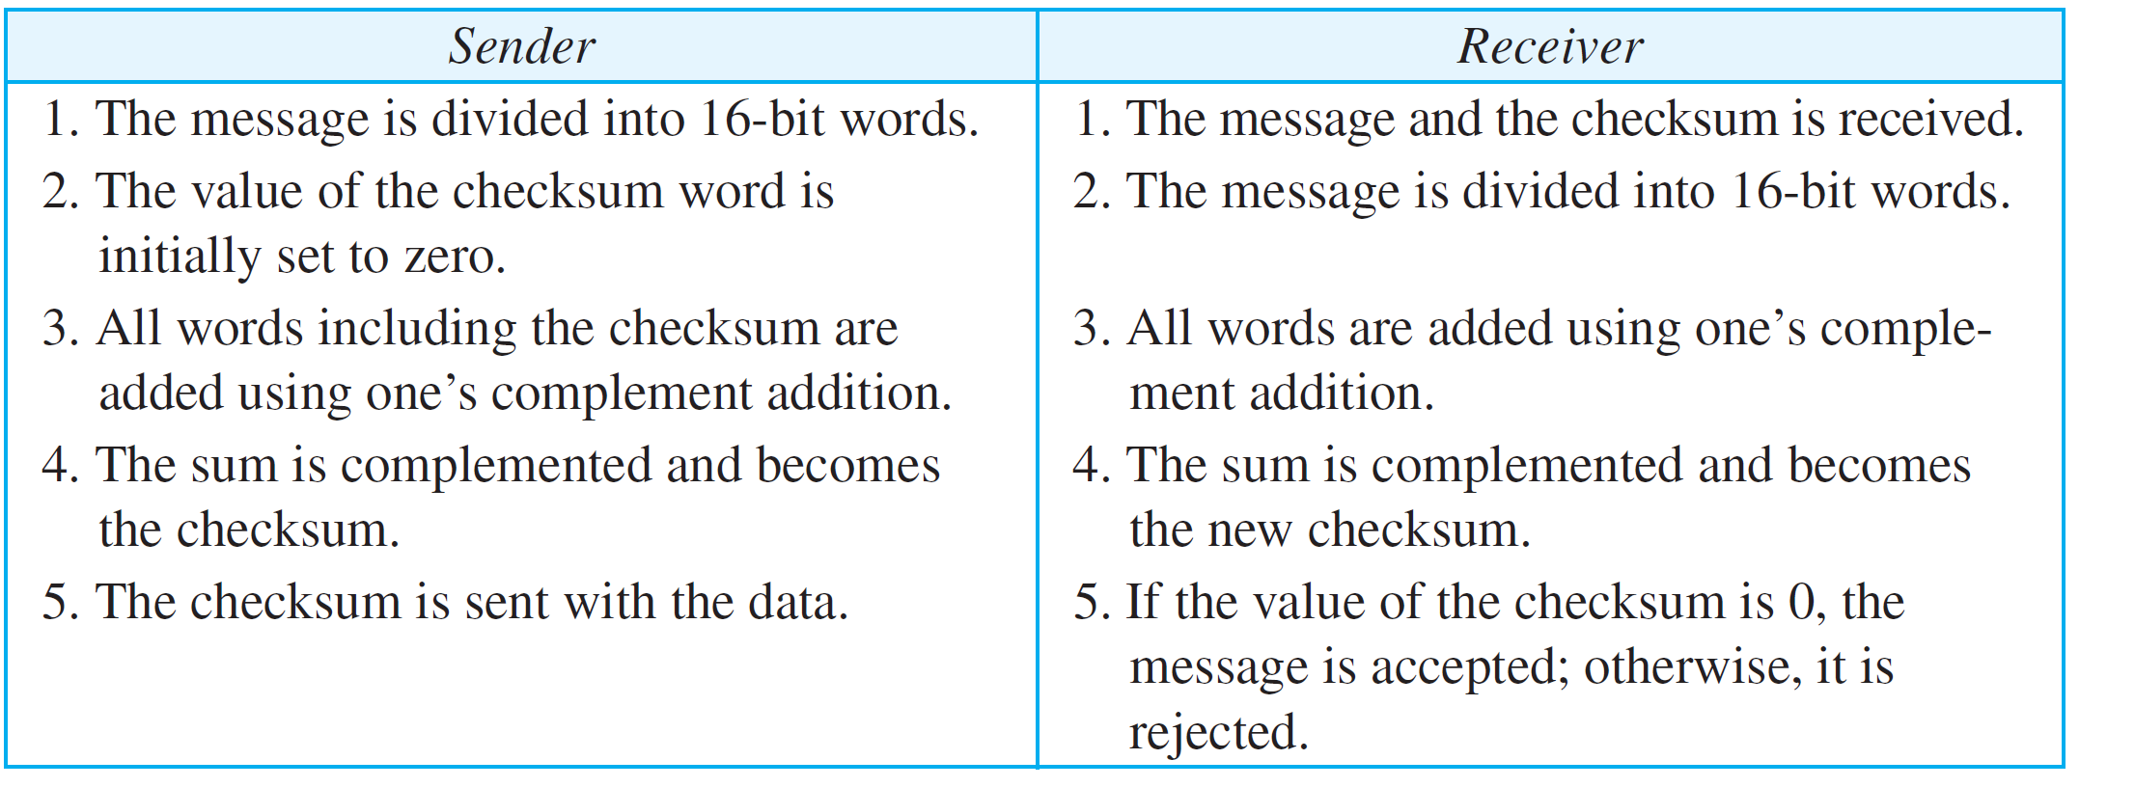
Procedure to find Checksum
Notes:
12.#

Slide 20
Summary
In this section we have discussed the following:
Single bit and multi bit errors
Finding Hamming Distance.
Block coding method for error detection.
CRC Method for error detection.
Checksum method for error detection.
Notes:
1.#

Slide 21

Notes:
1.#

